Slide 1
Week 4 CIS 215
the other side

Slide 2
Detecting Scans
IDS vs IPS
Scripts
Hacker vs legitimate user vs search engine spider
Snapshots
Checks of what is on the system
Traps and Triggers
Honeytraps and Canary
https://hackernoon.com/catch-your-hacker-use-honeypot-tools-to-capture-hackers-red-handed-u71b32cr

Slide 3

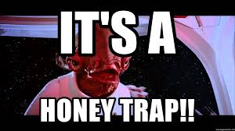
Examples of traps
Too small to read text
Honeytoken - Info that seems legitimate and juicy but isn't
Fake admin login info in plain text
https://github.com/secureworks/dcept
White on white text
Crawler traps for SEO
Robots.txt to tell legit bots how to avoid traps

Slide 4
Example: How to hide emails on websites
Image of email or @ symbol
Aholdengouveia necc.mass.edu
Replace mailto with script or use code to disguise the email
Bonus, if you use an email only scripts/bots read it becomes a honeytrap
Write out email
Aholdengouveia AT necc DOT mass DOT edu
CAPTCHA before email is given
Contact form to request an email rather than posting the email publicly
Keep in mind, anything you do that is abnormal can be difficult for accessible websites and software

Slide 5
Hiding Info
Naming Policies
Server names such as email03 easy to guess other 2 email servers
Email address
Are they posted online?
Do they follow an obvious naming scheme? If yes, do you publish your employee list?
Consider using generic emails CEO@acmecorp.com
Job descriptions, do you list the products you use?
Do you list your AV and networking needs in your job postings? If yes it's easy to guess your setup

Slide 6
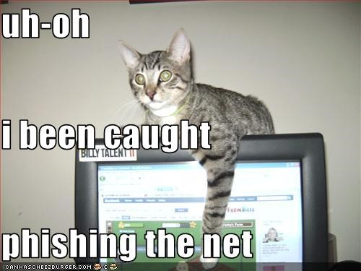
Activity
As pairs, discuss 1 more thing to add to how to hide info, hide email addresses, or a trap you think is valuable for a company to have set up. Be ready to share with the class

Slide 7
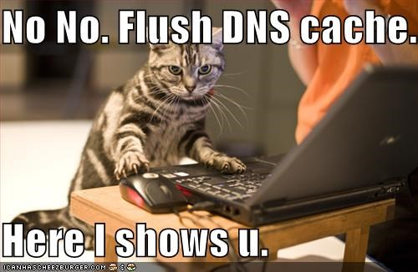
DNS
Split DNS for public and private access
Public should only show public facing servers
Private should show ONLY what's in network
Disable Zone transfers
Zone transfer means you replicate the DNS database across a set of DNS servers. BIG NO NO to allow this

Slide 8
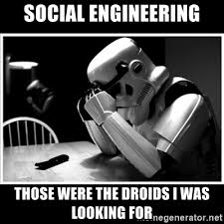
People
Social engineering
Do you have training to prevent social engineering?
Are your employees aware this is a concern?
Role Play to show what it looks like and how to prevent it
Security procedures and policies
Are you employees aware of the policies?
Are they following the policies?
If they aren't, why not? Is it a you problem? Or a them problem?

Slide 9
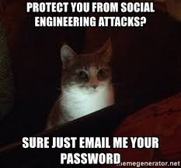
People cont.
As a company you shouldn’t use PII as authentication
Mother's maiden name isn't good proof you are you
Mission critical systems should have extra layers of protection
Think about doing air locked systems for the most sensitive of data
Do you educate your employees on what is public about them regularly?
Do they google themselves? Do you have google alerts set up?

Slide 10
DEMO let's use SET to spoof a website
In SET choose Web spoof, options 1-->2-->3 web spoof credential harvest

Slide 11
In depth: Phishing/Vishing/smishing Training
Phishing training
Show sample phishing emails
Phishing email campaign with an invite for more training
Spoofed email addresses
Dangerous links, shortened links and attachments
Vishing training for all employees with publicly search able numbers or those that interact with the public regularly (help desk, sales)
Threats or coercive language
The IRS will SUE YOU if you don't respond ASAP
Free phone if you click here, guaranteed win!
Time Pressures
This sale will END in the next 3 min so click now!

Slide 12
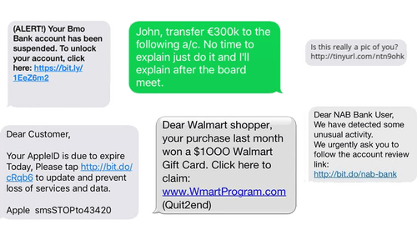
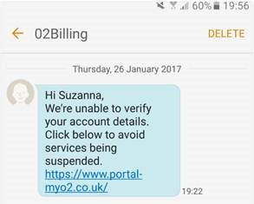
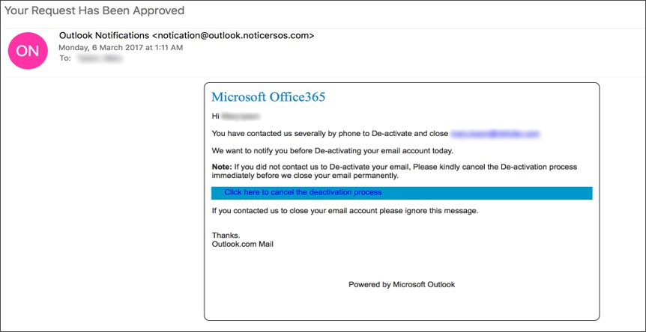
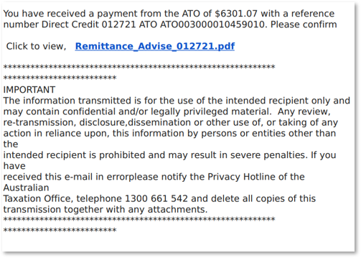
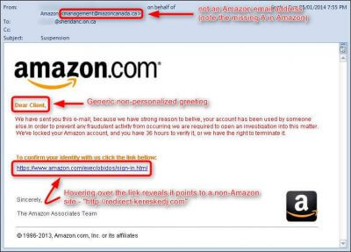
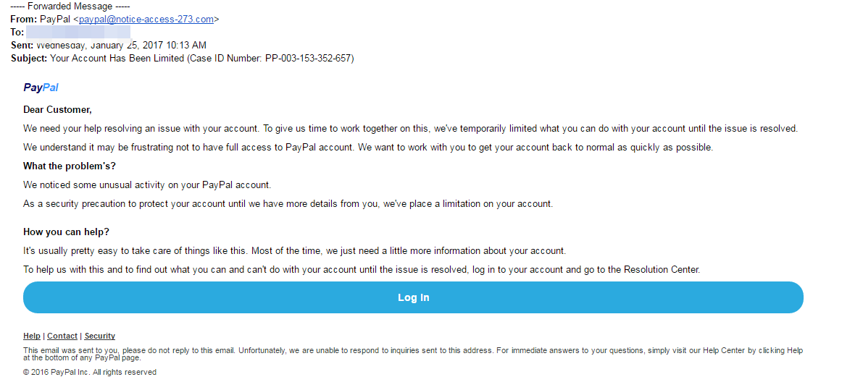
Phishing/smshing examples

Slide 13
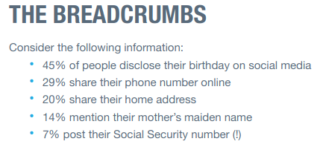
Reduce your Digital footprint tips
What are your employees saying about the company online? Even on private social media? What are they sharing about themselves? Do you have a policy on info sharing and IP?
Are you deleting old info? Old social media? Old job postings? What has been archived(If anything)?
Following breadcrumbs – Are you linked to old accounts? How much public data is available about your employees? Are they aware of what's available?
http://wow.intsights.com/rs/071-ZWD-900/images/How%20to%20Reduce%20Your%20Organization%27s%20Digital%20Footprint%20%26%20Cyber%20Risk.pdf

Slide 14
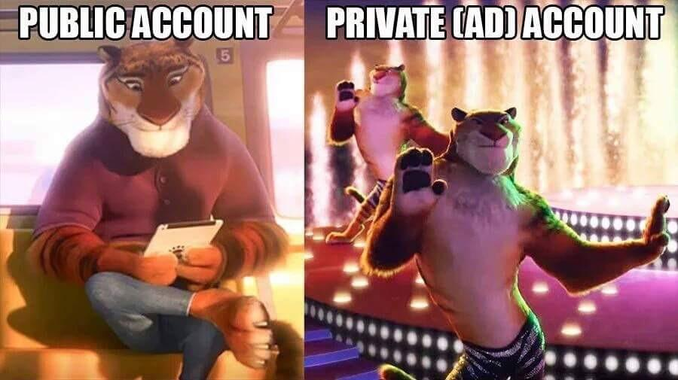
Activity
Now that you know about digital footprints. What's yours? What can you find about yourself online? What alerts do you have set up?
IF you are comfortable with it, you can switch with someone and look them up. !!NOT REQUIRED OPTIONAL!! Be careful of what you find

Slide 15
System Hardening
Ports
What's open? Is that still needed?
Services
What's running? Is that still needed? Can you get rid of it? Any extras on the system is one more potential vulnerability for a hacker to find
Patch management
What is your update cycle? Patch cycle? How often do you audit your systems?
Security checkups
Lynis – Used in Linux Admin, if you're not taking Linux Admin, try it out.

Slide 16
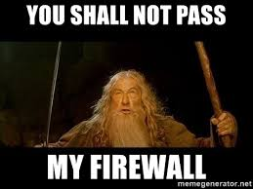
Firewalls, routing and Layers
Firewalls are used to direct traffic
The default options are accept, deny (drop no response) or redirect
Packet inspection vs Deep packet inspection
More to come during Firewall week!

Slide 17
Policies and Procedures
Audits
Frequent security audits to make sure everything is still in date and valid. For example, if you haven't had a winXP machine in 10yrs do you still need them running? Are they controlling anything?
Are you keeping a running log of changes to the infrastructure and devices
Device management
BYOD? Are there rules such as lockers for all devices before getting on the campus?
Password controls
What's your password policy? What about shared passwords? Who holds master passwords? How do you backup the passwords? Who updates the backups?
Hit by a bus
Is your plan and backup and backup of the backup a single person? What if any one or two aren't in? Then what?

